Slide 1
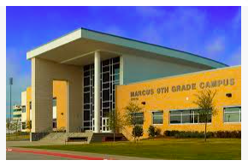
Registration To-Do List:
Review the Digital Registration Notebook
Choose 4-core classes (English, Math, Science, Social Studies)
Choose 4 elective classes
Choose 4 alternate electives
Enter Course Requests and Alternate options in Skyward no later than Tuesday, January 31st at 11:00 PM.
Counselors
ELA/Math
Science/SS
Welcome to Marcus 9th Grade Center
Languages
Marcus 9th Grade
Athletics/PE
*Please use the arrows to click through every page as you will miss information by clicking on the tabs.
Fine Arts
Electives

Slide 2
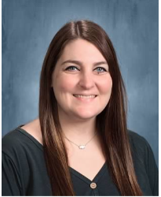
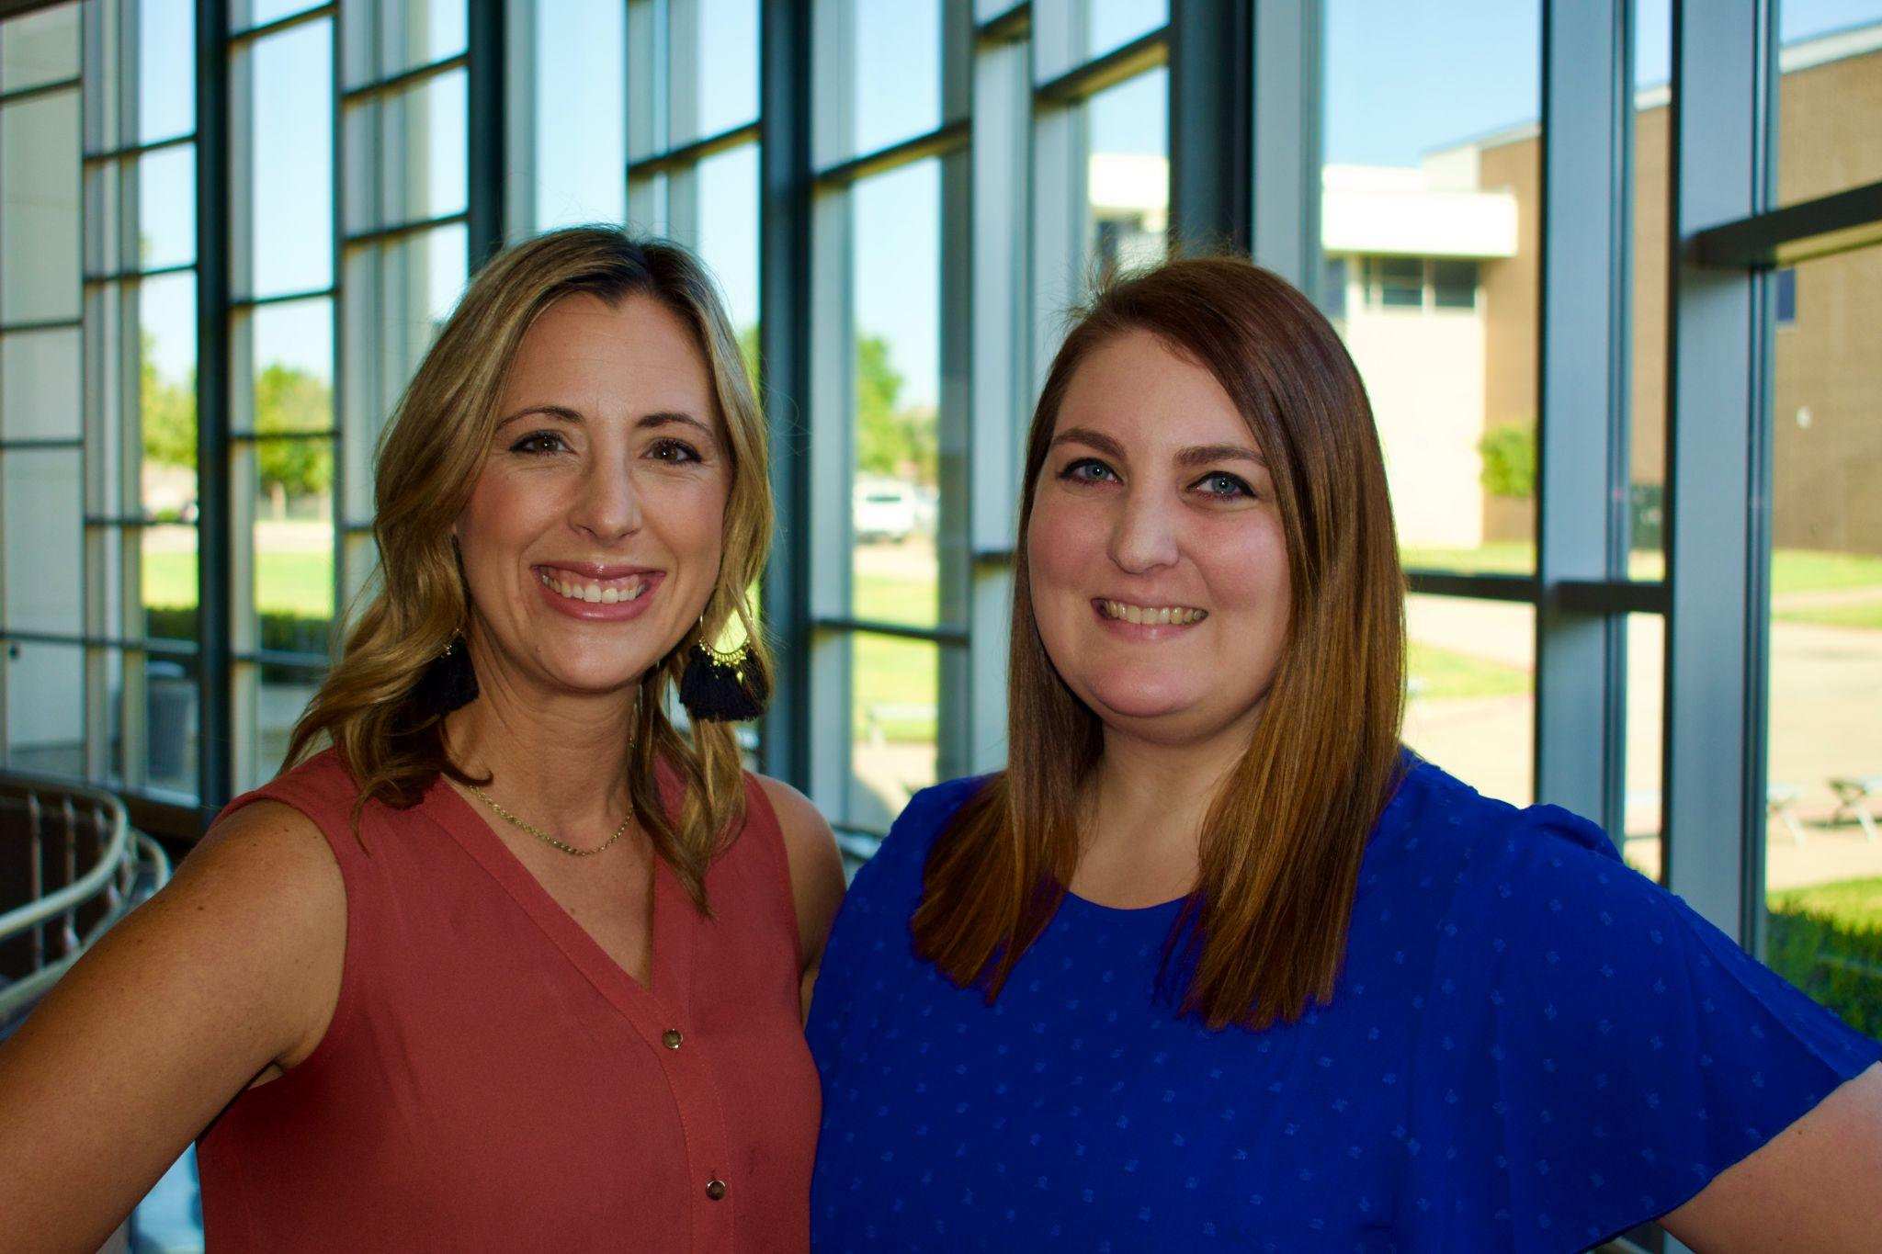
Meet our Counselors:
Table of Contents
Counselors
Counselors
Registration Information
English & Math
Science & SS
Foreign Language (LOTE)
Elective Options- Athletics/PE
Elective Options - Fine Arts
Elective Options - Other
VLA Elective Options
Career Center Elective Options
External PE Options
ELA & Math
Science/SS
Amanda Gallant Counselor for Students: A-K Phone: 469-948-8919 Email: gallanta@lisd.net
Ria Morrison Counselor for Students: L-Z Phone: 469-948-8916 Email: morrisonr@lisd.net
Languages
Athletics/PE
Fine Arts
Electives

Slide 3
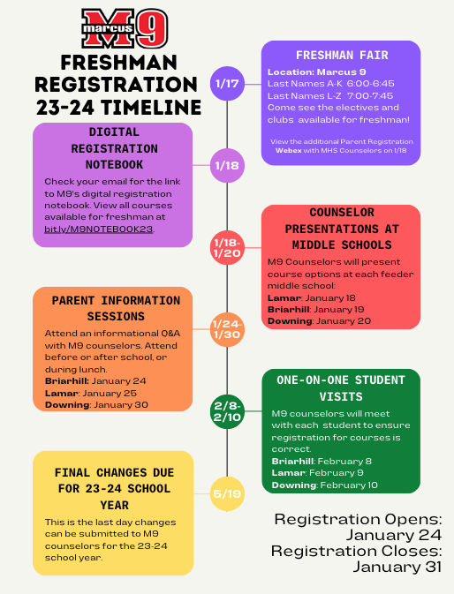
Registration:
Home
Counselors
Please click the below image to access the M9-At-A-Glance Presentation.
ELA & Math
Science/SS
Languages
Click HERE for helpful links!
Athletics/PE
Fine Arts
Electives

Slide 4
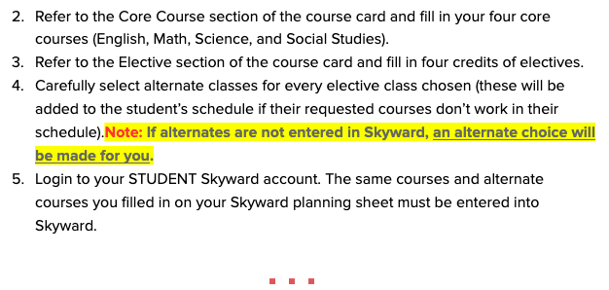
Planning Your Courses:
Home
Counselors
ELA & Math
Science/SS
Languages
Athletics/PE
Fine Arts
Video instructions for entering course requests into Skyward Family Access. *NOTE: Remember to use your STUDENT’S LOGIN to enter requests.
Electives

Slide 5
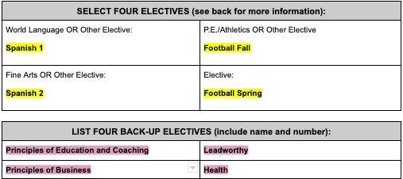
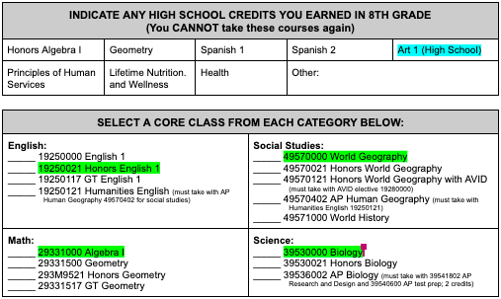
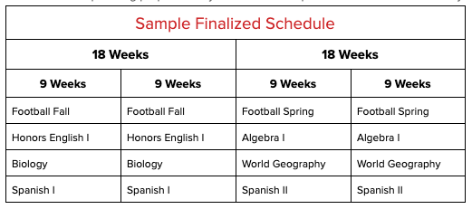
Registration Planning:
Home
Counselors
Link to Print: Course Card
ELA & Math
Science/SS
Languages
Athletics/PE
Fine Arts
*Alternate classes will be used to replace an elective that does not fit in the student’s schedule.
Courses are REQUESTS only. NO courses are guaranteed.
Electives

Slide 6
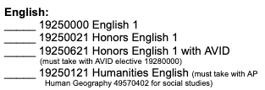
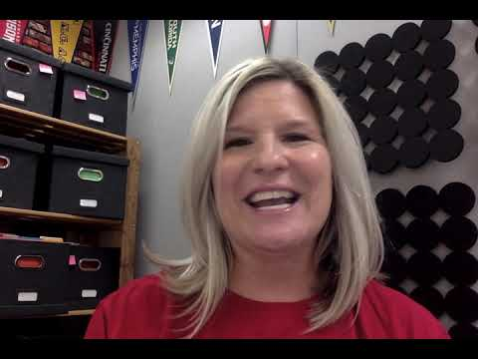
English
Math
Home
Counselors
ELA & Math
Science/SS
Algebra 1
English
Languages
Athletics/PE
Geometry
Honors English/AVID
Fine Arts
Math flow Chart
Course Description Guide
Electives

Slide 7
Science
Social Studies
Home
Counselors
ELA & Math
AP BIO is a main campus class-Questions? Contact Mr. Hinsley
Science/SS
Languages
Social Studies
Foreign Lang.
Electives
Course Description Guide

Slide 8
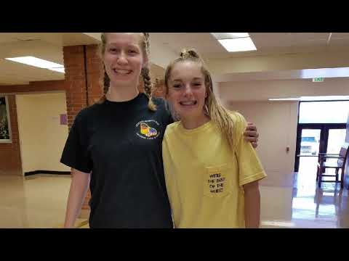
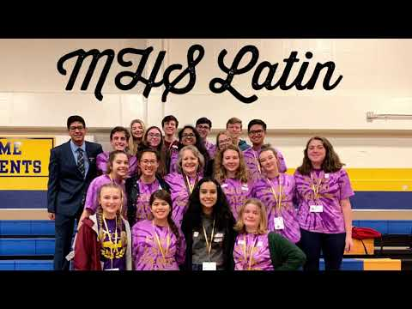
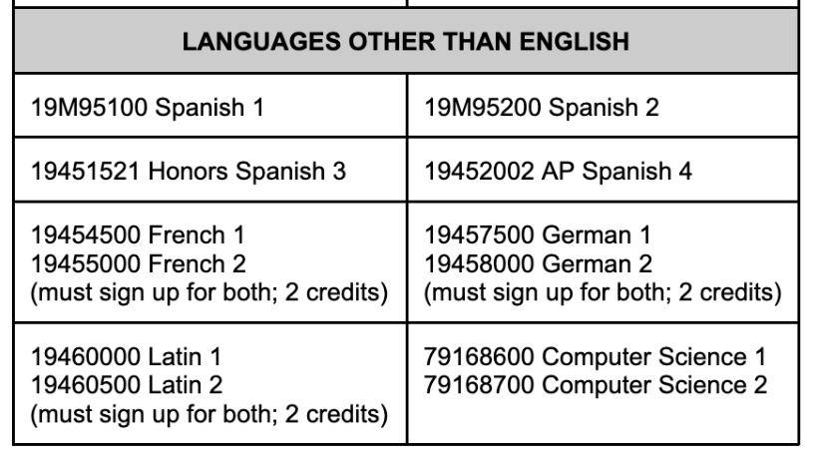
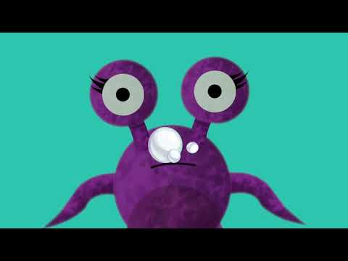
Foreign Language
Home
Counselors
German 1 & 2
ELA & Math
Spanish 1 & 2
Science/SS
Latin 1 & 2
Languages
Athletics/PE
VLA ASL 1 & 2
Fine Arts
Level 1 should be taken in the Fall, and Level 2 should be taken in the Spring.
If planning to take AP Spanish 4, students MUST taken Honors Spanish 3.
Course Description Guide
Electives

Slide 9
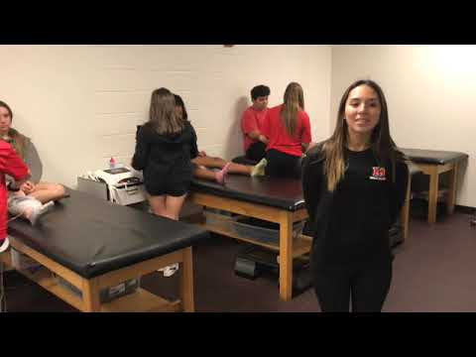
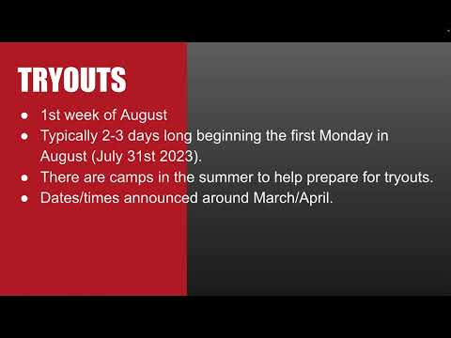
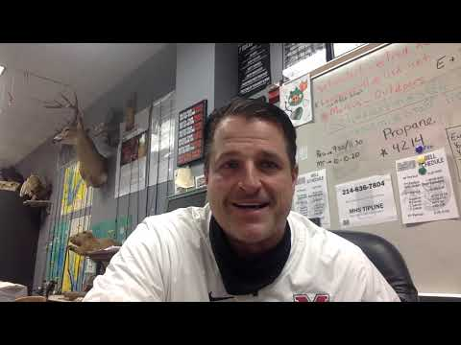
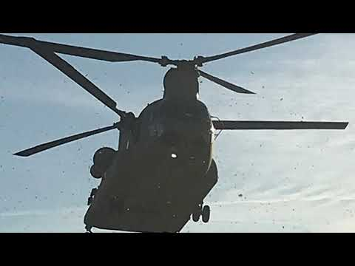
Athletics/PE
Home
Counselors
9th Grade Course Card
Sports Medicine
Wrestling
ELA & Math
Some course description videos are included on the next few pages however, to see the COMPLETE LIST OF ELECTIVES, click the link above.
Science/SS
Athletics (Choose Fall & Spring)
Team sport (football, volleyball, etc)
Cheerleading
Drill Team
P.E:
Lifetime Fitness and Wellness Pursuits
Lifetime Recreation and Outdoor Pursuits
Skill-Based Lifetime Activities
Other P.E. Credits:
External PE (fee & application required)
Dance 2 (prerequisite: Dance 1)
JROTC 1
Band/Colorguard (0.5 credit each year for marching season)
Cross Country/Track & Field Flyer
Languages
Volleyball
Cheer
Athletics/PE
Fine Arts
Outdoor Education
JROTC
Course Description Guide
Electives

Slide 10
Athletics/PE
Home
ATHLETIC COACHES & EMAILS:
*Football: Coach Morrison
Baseball: Coach Sherman
Softball: Coach Tumilty
Volleyball: Coach Petzold
Basketball Boys: Coach Wright
Basketball Girls: Coach Singleton
Soccer Boys: Coach Garza
Soccer Girls: Coach Hobbs
Swim/Dive: Coach Dion
*Wrestling: Coach Stoeberl
Tennis: Coach Langdon
Golf: Coach Gabel
*Track & Field *Cross Country: Coach Reinberg
Athletic Trainer: Bethany Brunett
Athletic Director: Kevin Atkinson
Counselors
9th Grade Course Card
ELA & Math
Marcus Sports Season
Fall | Winter | Spring
Cross Country* | Basketball | Track*
Football (Boys)* Volleyball (Girls) | Wrestling* | Baseball (Boys) Softball (Girls)
Tennis | Soccer | Tennis
Golf | Swim/Diving | Golf
Science/SS
Languages
Athletics/PE
*NO Tryouts required
Fine Arts
Electives
Course Description Guide

Slide 11
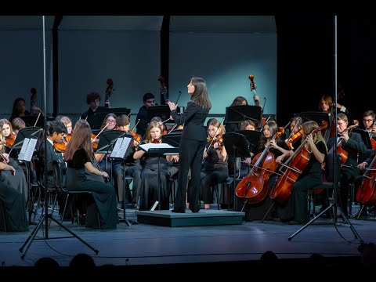
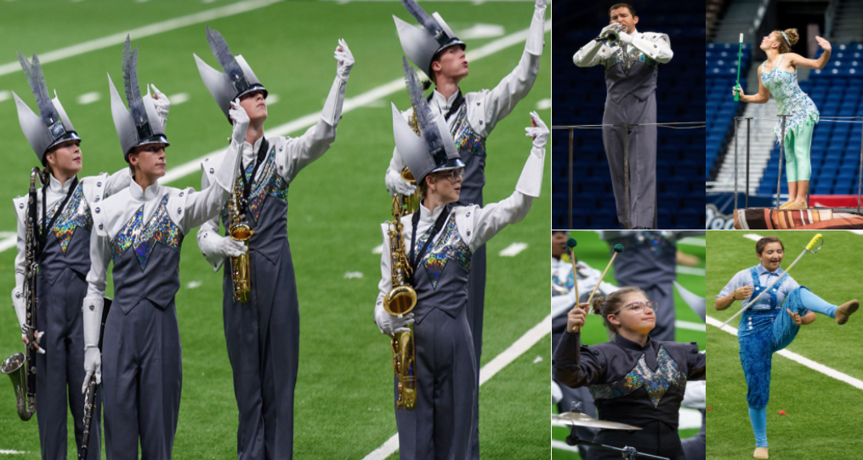
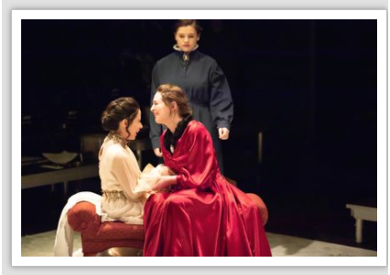
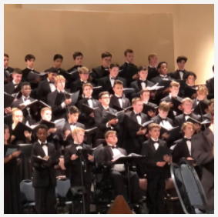
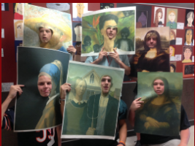
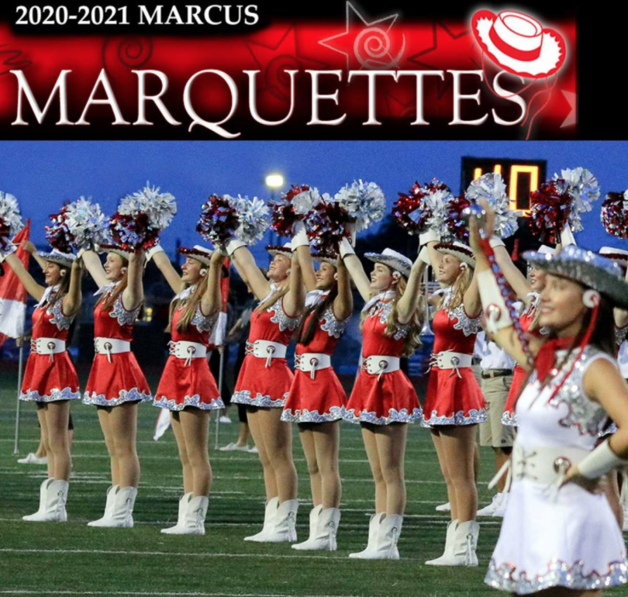
Fine Arts
Home
Counselors
Orchestra: Ms. Washler
9th Grade Elective Class Options
ELA & Math
Band: Mr. Jones
Science/SS
Theater:
Ms. Tooch
Languages
Choir:
Mr. Davis
Athletics/PE
Visual Arts: Ms. Hobza
*Click here for Art Flyer
Dance: Ms. Dack
Fine Arts
Electives
Course Description Guide

Slide 12
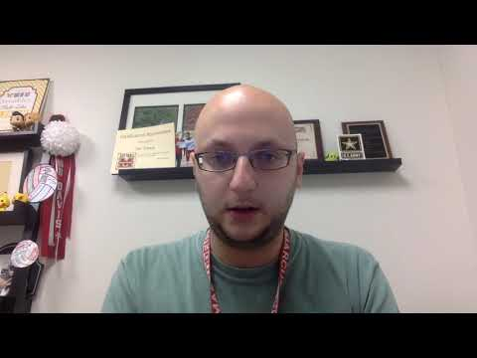
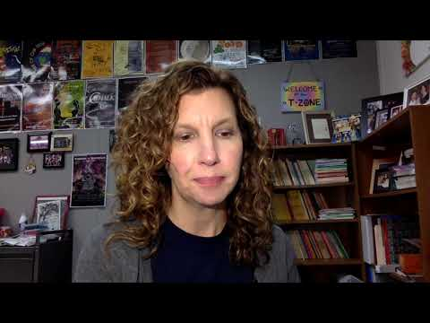
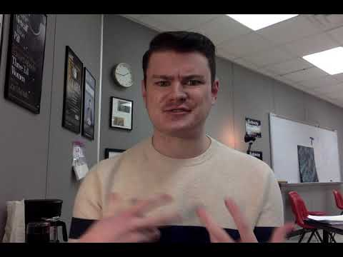
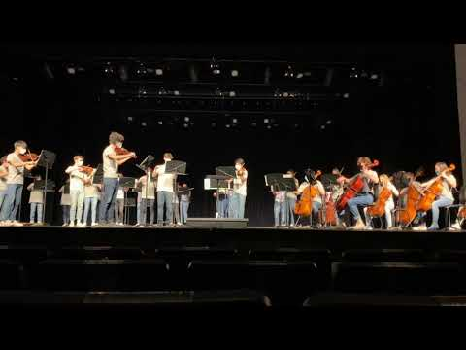
Fine Arts
Home
Counselors
9th Grade Course Card
ELA & Math
Theatre Arts
Science/SS
Band
Languages
Marcus Color Guard has auditions coming up in April. Our yearly audition process in April is the entry point into the fall and spring color guard classes. We are open to anyone and no experience is necessary. Students receive PE and Fine Arts credit.
Technical Theatre
Color Guard
Athletics/PE
Fine Arts
Art 1 (Visual Arts)
Orchestra
Electives
Course Description Guide

Slide 13
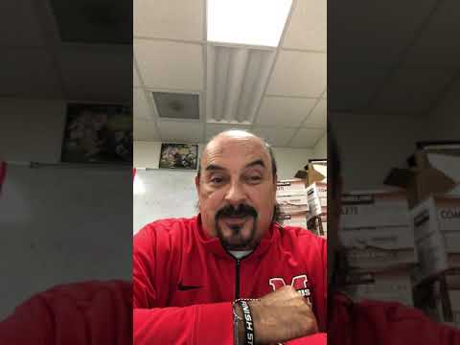
Other Electives
Home
Counselors
9th Grade Course Card
Journalism
ELA & Math
Leadworthy
Science/SS
Business Information Management
Money
Matters
Languages
Athletics/PE
Digital
Media
Education and Coaching Program
Fine Arts
Family and Consumer Sciences
Robotics
Electives
Course Description Guide

Slide 14
VLA Elective Options
Home
Counselors
LISD VLA Website VLA FAQs
*Please check the website frequently for any updates on course offerings and availability.
VLA Registration Card 2023/2024
*Students may only sign up for 2 VLA Classes:
1 in the Fall and 1 in the Spring.
Students can only take VLA 1st or 4th periods (OFF CAMPUS).
VLA Spanish 1
ELA & Math
Science/SS
Link to VLA Course Options
VLA Art 1
Languages
VLA: MythBusting
Athletics/PE
VLA ASL1 & 2
Fine Arts
Why Choose VLA?
Electives
*No fee for classes taken during 1st, or 4th periods except for Chinese and German.

Slide 15
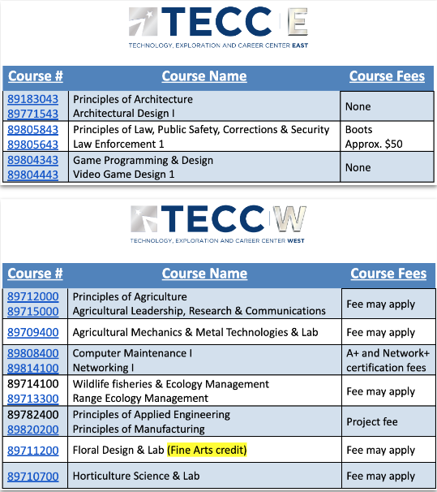
Career Center Elective Options
Home
Virtual Tours
Counselors
LISD Career Center Website
ELA & Math
Science/SS
Languages
Athletics/PE
Fine Arts
Electives
*Please visit the LISD Career Website link to view course specific videos.

Slide 16
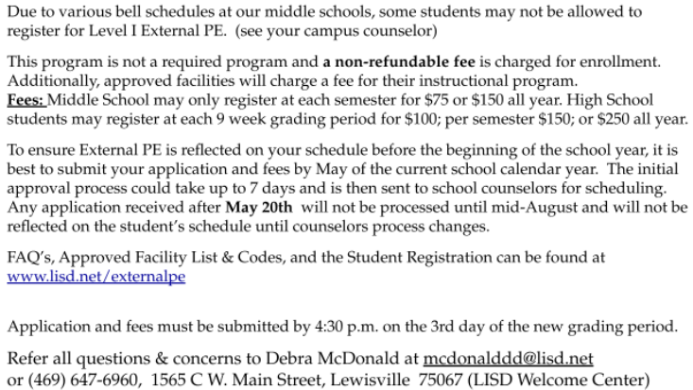
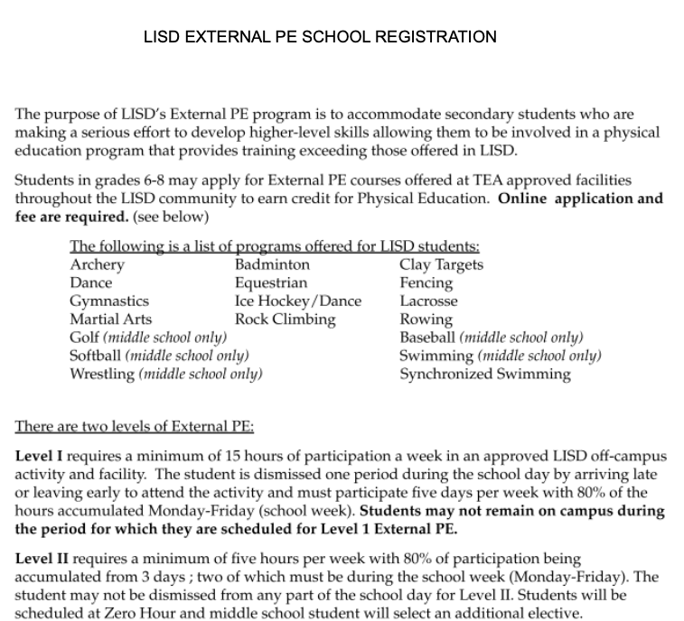
External PE Elective Options
Home
Counselors
LISD External PE Website
ELA & Math
Facility Applications for the 2023-24 school year must be submitted for approval to the LISD External PE program by May 20, 2022
Science/SS
Languages
Athletics/PE
Fine Arts
Electives

Slide 17
Thank you!
Counselors
ELA &Math
Looking forward to an AMAZING 2023-2024!
Science/SS
Languages
Athletics/PE
Fine Arts
Electives
Home

